Slide 1
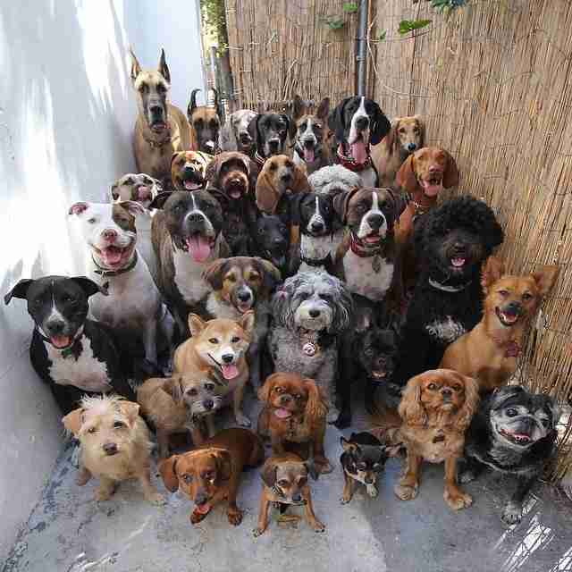
Canine Facial Recognition
Breed recognition using tensor flow pretrained imaging models
Rutgers
Data Science Bootcamp
Terry, Carlos, Nrupesh, Mugdha, Hua

Slide 2
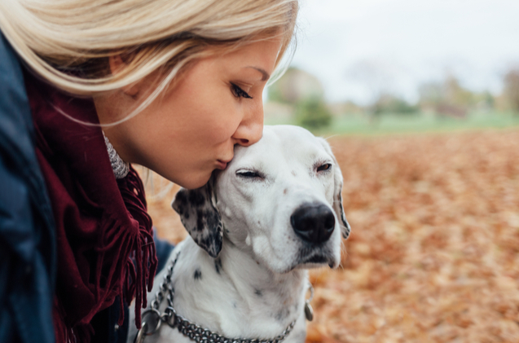
What we are going to cover on this presentation?
Can we identify a dog’s breed through Image recognition?
Creating a UI for any user to identify the breed by uploading a picture
Comparing different machine learning models for image recognition

Slide 3
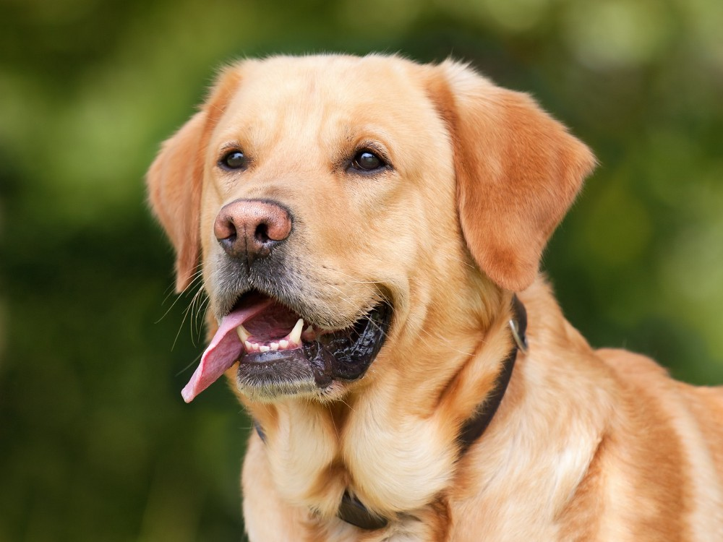
Objective: Can we identify a dog’s breed through Image recognition?
What is ImageNet?
ImageNet is a project which aims to provide a large image database for research purposes. It contains more than 14 million images which belong to more than 20,000 classes ( or synsets ).
What are Convolutional neural network?
Convolutional neural networks (CNNs) are a special category of deep neural networks that are specifically designed to work with images. CNNs have multiple layers, with each layer connected to the next by “convolutions.”
Rutgers University Boot Camp

Slide 4
Extraction
Reference Data, Data Types, Data Validation
Reference Data
Stanford Dogs Dataset- http://vision.stanford.edu/aditya86/ImageNetDogs/
Number of categories: 120
Number of images: 20,580
Annotations: Class labels, Bounding boxes
Data Types
Images - Images of different breeds are in separate folders –
Annotations - Bounding box annotations of images
File_list.mat – List of all files in the dataset
Train_list.mat –List and labels of all training images in dataset
Test_list.mat -- List and labels of all test images in dataset
Data Validation
train_data/test_data -- contains the feature matrix after histogram intersection kernel has been applied
train_fg_data/test_fg_data -- contains the feature matrix before applying the histogram intersection kernel –
train_info/test_info -- contains the labels and ids for the corresponding image in the feature matrix
Rutgers University Boot Camp

Slide 5
The four pretrain models
Xcpetion, VGG19, Inception, Resnet 50
load libraries
import matplotlib.pyplot as plt
import os
import numpy as np
import tensorflow as tf
import pandas as pd
import scipy.io
import numpy as np
from os import listdir
from os.path import isfile, join
from PIL import Image
ML libraries
from tensorflow.keras.preprocessing import image
from keras.preprocessing.image import img_to_array
from keras.applications.imagenet_utils import decode_predictions
from keras.preprocessing.image import load_img
Model Libraries
from tensorflow.keras.applications.xception import (Xception, preprocess_input, decode_predictions)
from tensorflow.keras.applications.vgg19 import ( VGG19, preprocess_input, decode_predictions)
from tensorflow.keras.applications.resnet50 import (ResNet50, preprocess_input, decode_predictions)
from keras.applications.inception_v3 import InceptionV3
Rutgers University Boot Camp

Slide 6
The four pretrain models
Xception | Vgg19 | ResNet 50 | Inception V3
On ImageNet, this model gets to a top-1 validation accuracy of 0.790 and a top-5 validation accuracy of 0.945. | On ImageNet, this model gets to a top-1 validation accuracy of 0.710 and a top-5 validation accuracy of 0.784. | On ImageNet, this model gets to a top-1 validation accuracy of 0.681 and a top-5 validation accuracy of 0.733. | On ImageNet, this model gets to a top-1 validation accuracy of 0.540 and a top-5 validation accuracy of 0.595.
This model only supports the data format “channels_last”(height, width, channels). | This model can be built both with “channel_first” or “channel_last” data format. | This model can be built both with “channel_first” or “channel_last” data format. | This model can be built both with “channel_first” or “channel_last” data format.
The default input size for this model is 299x299. | The default input size for this model is 224x224. | The default input size for this model is 224x224. | The default input size for this model is 224x224.
Rutgers University Boot Camp

Slide 7
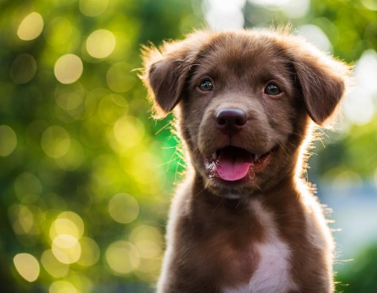

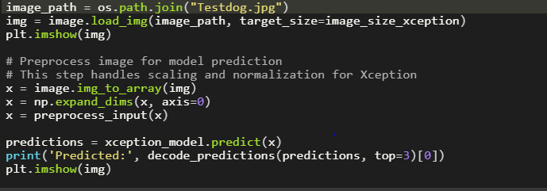
Transformation of data
Utilizing the order of thousands of images
Modifying each model to run for multiple images
Analyze the results
Rutgers University Boot Camp

Slide 8
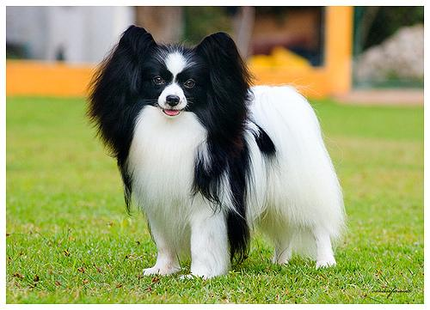
Transformation of data
Utilizing the order of thousands of images
18,000+ images
Each image had a unique file name
Images were sorted into separate directories by breed
Rutgers University Boot Camp

Slide 9
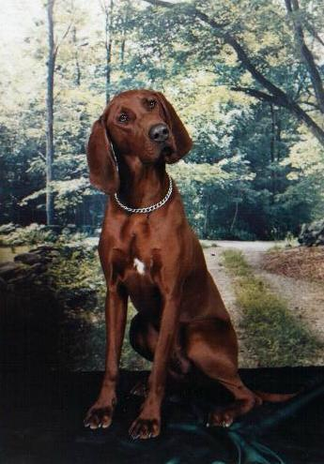
Transformation of data
Modifying each model to run for multiple images
Goal
Keeping track of the actual breed for every image
Create a queue for the models to draw from to create a loop for the models to cycle through each picture
Actual
Created a dataframe listing every file, breed, file path and exported to csv file.
Could not get the code to cycle to open files using every file path.
Settled for manually moving a random 100 files to a directory. Used the csv file to track each pic and breed to compare with the predictions.
Rutgers University Boot Camp

Slide 10
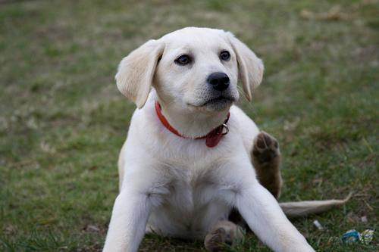
Transformation of data
Analyze Results
Goal
Loop model for 100+ pictures. Track predictions vs actuals.
Create a queue for the models to draw from to create a loop for the models to cycle through each picture
Actual
Created dataframe from filepath list to track actuals. Created a separate array of model results.
Created Confidence Matrix.
Tracked the probability that each model assessed on its prediction.
Rutgers University Boot Camp

Slide 11
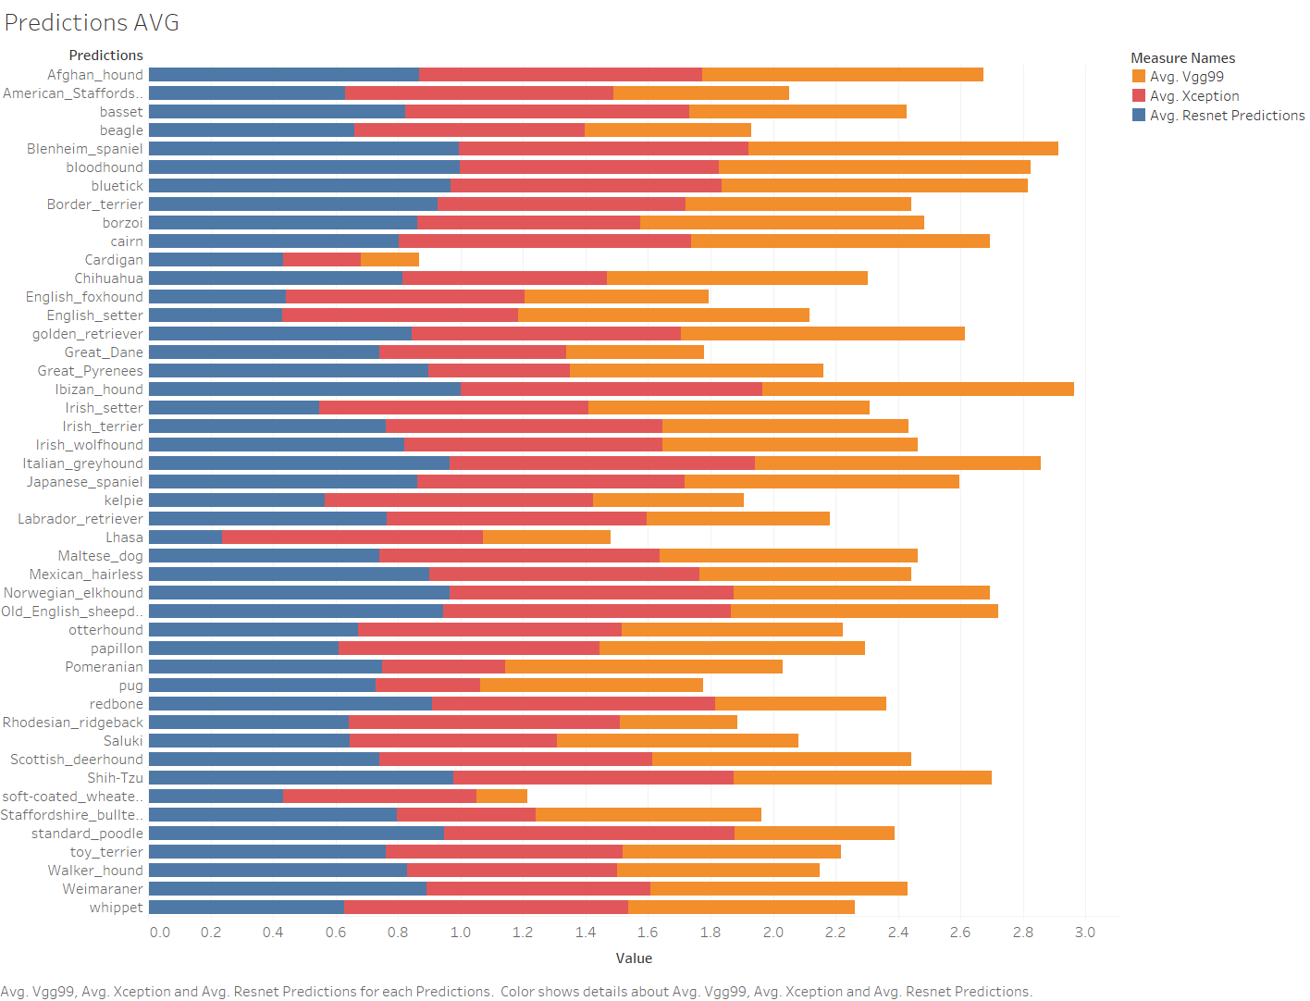
Visualization
Comparing all 3 models predictions
Lowest accuracy – Cardigan, Lhasa, Soft Coated Weat
Highest Accuracy-Afghan Hound, Ibazan Hound, Beinham Spaniel
Why Xception is the best model
Rutgers University Boot Camp

Slide 12
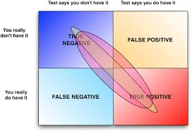
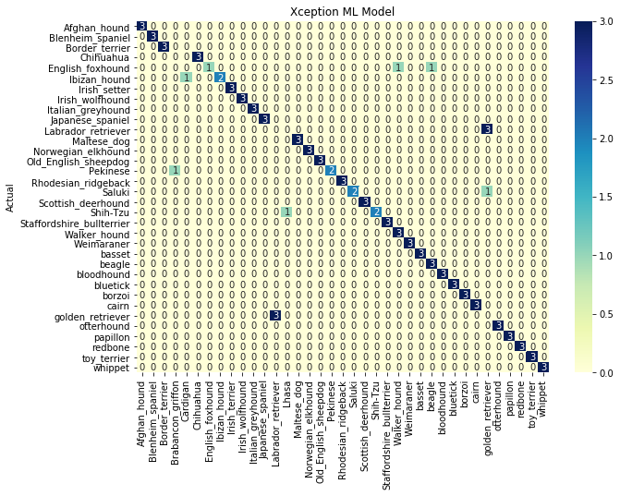
HeatMap- Xception
Making sense of the Confusion Matrix
Why are outliers not good
Looking at false positives and false negatives
Rutgers University Boot Camp

Slide 13
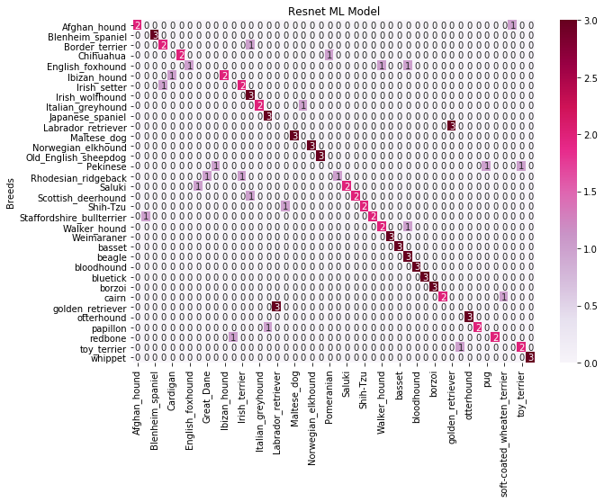
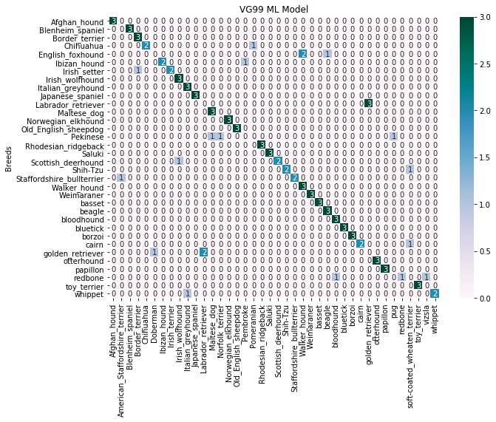
Heat Map- Comparing Models
Comparing VG99 and Resnet
Rutgers University Boot Camp

Slide 14
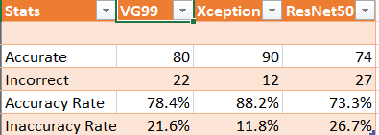
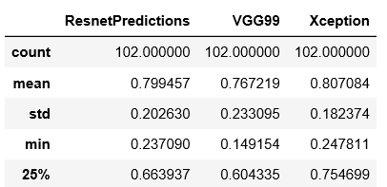
Statistics and Measures
Which Model gave us the best prediction
Rutgers University Boot Camp

Slide 15
Challenge of Deploying the ML Models into Production
Introduction
Nowadays it is easy to build - train and tune - powerful machine learning (ML) models using tools like Spark, Conda, Keras, R etc. The business value of these models, however, only comes from deploying the models into production.
Deploying Machine Learning models in production is still a significant challenge. There is no general strategy that fits every ML problem and/or every company’s need.
Deployment can be done in wide variety of ways, which entails either loading the model directly into the application or making API’s and calling them from the application.
The strategy you choose will depend on various factors, such as: type of model you’re using, whether model training is online or offline, whether predictions are batch or on-demand. Other considerations include performance requirements and degree of feature engineering.
Some strategies:
In most cases, we cannot load the model directly in the application so we need to select one of the below.
Building customized REST API with Python Web framework. Flask, Django and Dash are the most popular.
Kubernetes and Docker Container: The model and dependencies are packaged in Docker container and Kubernetes is used as orchestrator. As an orchestration manager, Kubernetes can handle among others things, automated health checks and autoscaling.
AWS Lambda serverless service is another possible option. More details here
here
TensorFlow Serving: An open-source high-performance serving system for Machine Learning models. More details here
Using Shiny Server or shinyapps.io to host shiny applications. More details here
Rutgers University Boot Camp

Slide 16
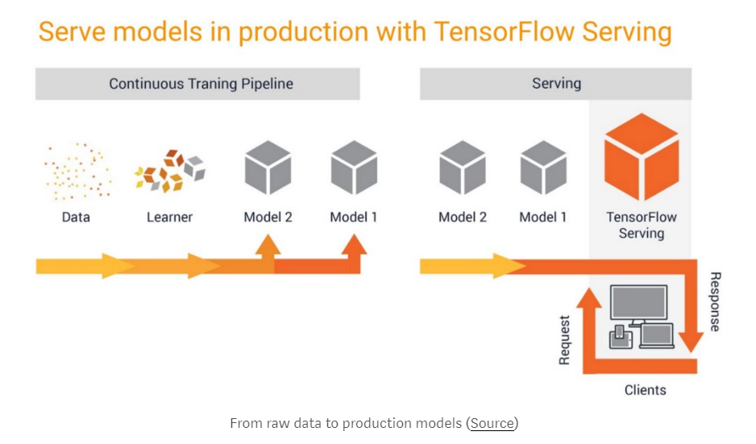
TensorFlow Serving
Rutgers University Boot Camp

Slide 17
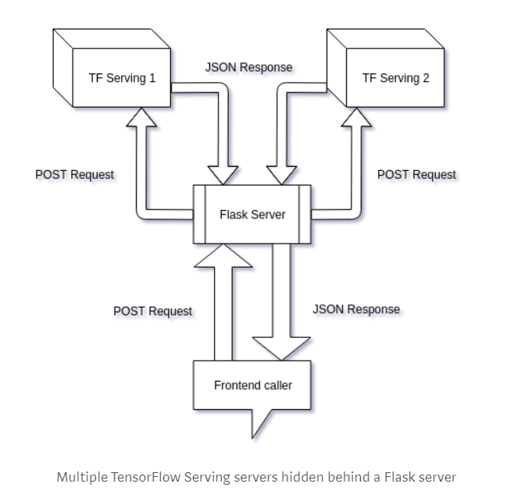
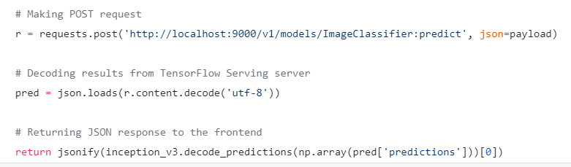
TensorFlow Serving
Rutgers University Boot Camp

Slide 18
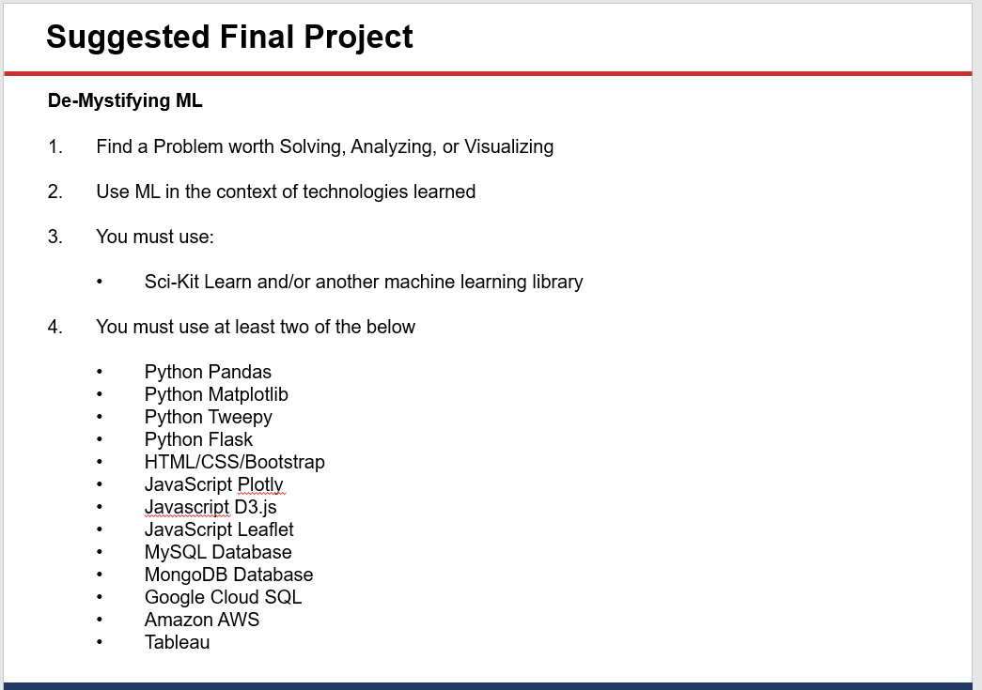




The Knowledge We Utilized in this Project
Dog Breeds Recognition
Solving with three ML models
Analyzing accuracy and best model
Visualizing with confusion hotmap, statistics excel, web page
Sci-Kit Learn and TensorFlow libraries
Rutgers University Boot Camp

Slide 19
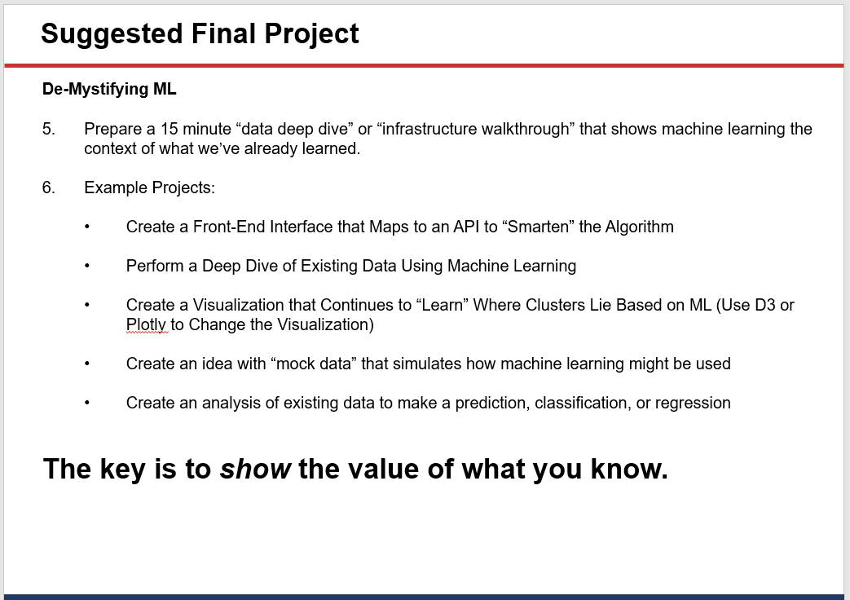


The Knowledge We Utilized in this Project (continued)
Rutgers University Boot Camp

Slide 20
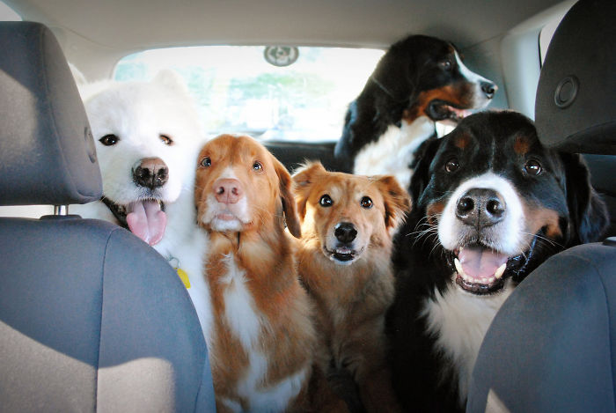
Thank You
Rutgers University Boot Camp

